Slide 1
How can poverty be as much a mindset as a lack of material resources?

Slide 2
What is poverty?

Slide 3
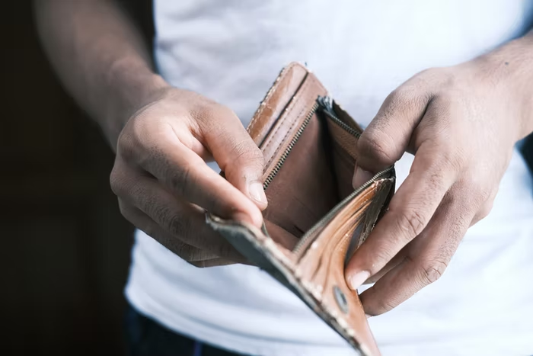
What is poverty?
Poverty is about not having enough money to meet basic needs including food, clothing and shelter.
Essentially, poverty refers to lacking enough resources to provide the necessities of life
Poverty is the state of having few material possessions or little income.
Poverty means not being able to heat your home, pay your rent, or buy the essentials for your children.

Slide 4
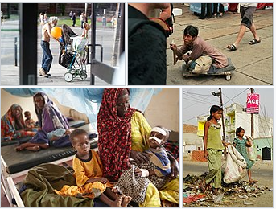
Biblical view
Poverty will attack you
Proverbs 6:11
Poverty thrives on ignorance
Proverbs 13:18
Poverty will limit your circle of friends
Proverbs 19:4
Poverty will destroy you
Proverbs 10:15

Slide 5
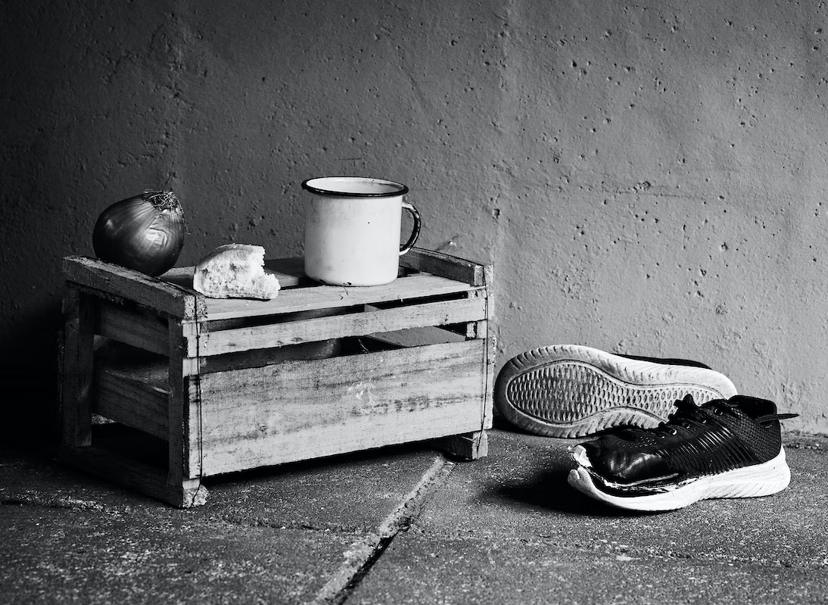
Poverty produce negative mindset
Scarcity mentality focus on the immediate needs
Producing a short-term strategy to cope
Negative perception by others
More risk taking behaviour
Low level of confidence and less likely to succeed
Increase the risk of mental illness
Low self esteem and low sense of belonging
Children show reduced cognitive performance

Slide 6
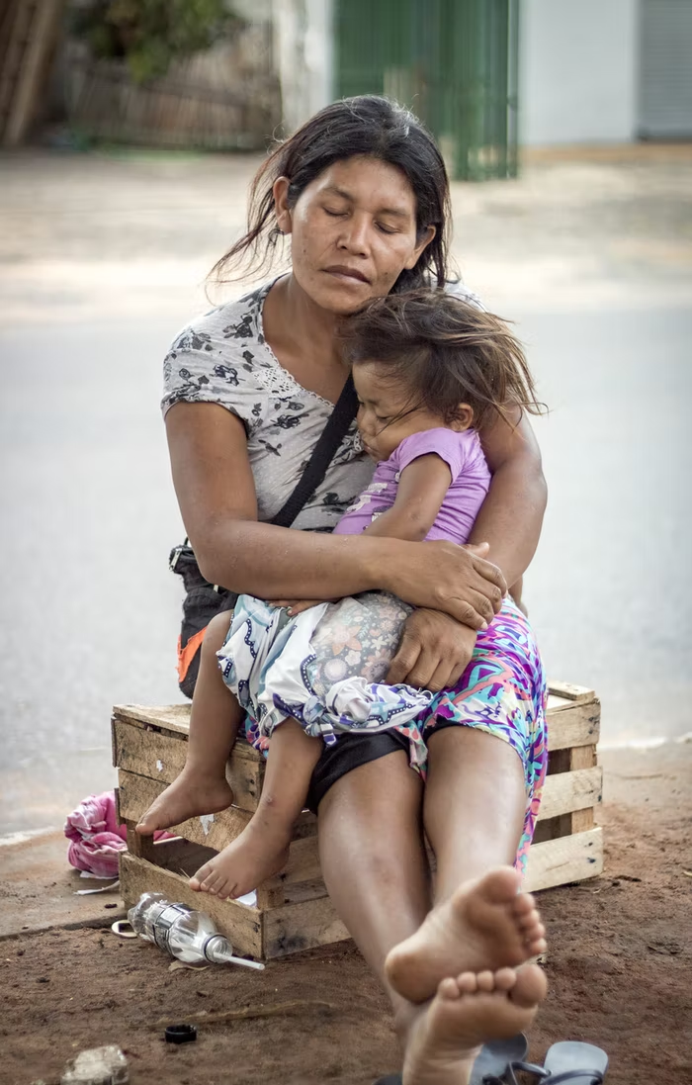
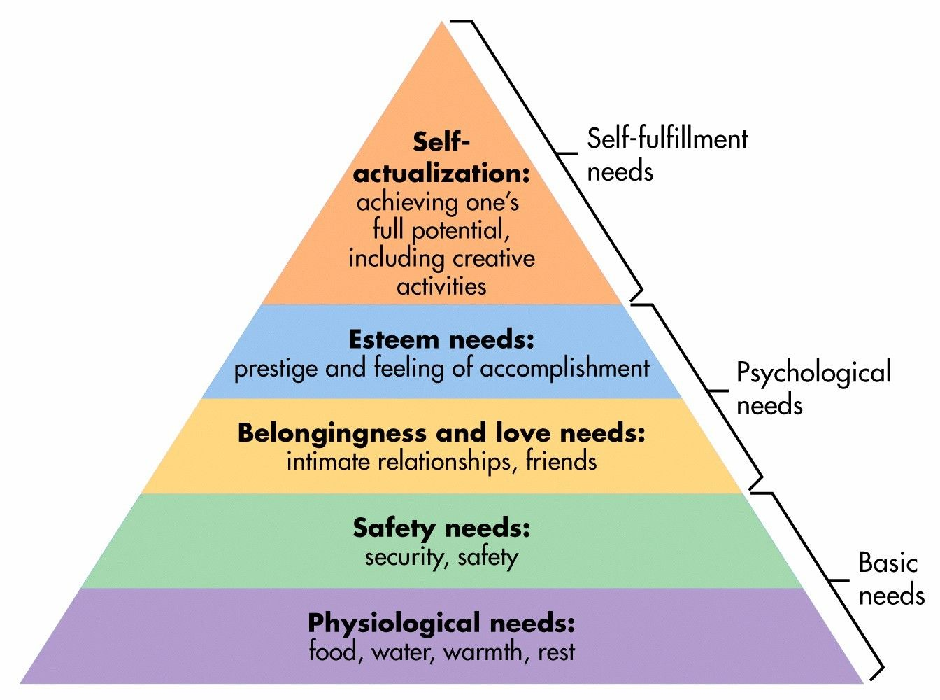
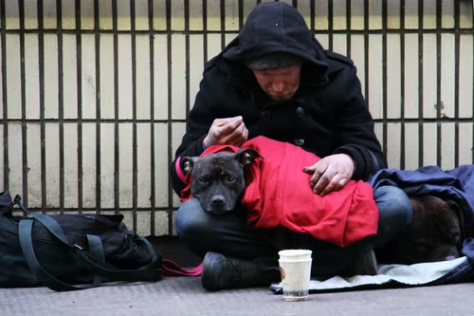
The worst of the poverty mindset
It destroys hope!

Slide 7
Break the poverty mindset
Need a helping hand
'The thief comes only to steal and kill and destroy; I have come that they may have life, and have it to the full.'
John 10:10-15
“Speak up for those who cannot speak for themselves, for the rights of all who are destitute. Speak up and judge fairly; defend the rights of the poor and needy.”
Proverbs 31:8-9 (NIV)
Need someone to tell them that they are worthy
To shine light through their dark world

Slide 8
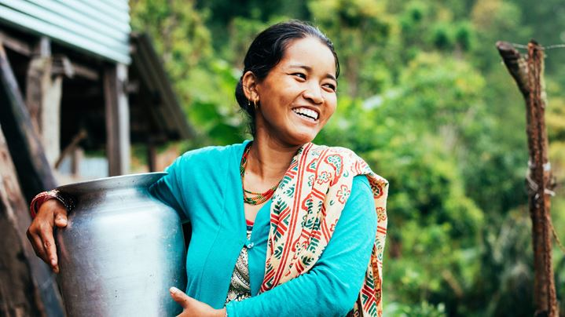
Restore hope to change the poverty mindset
Look beyond immediate needs
Think long term and dream dreams
Positive perception by others
Use gifts and talents
Improve the level of confidence and to succeed
Healthier life reduce the risk of mental illness
Increase self esteem and sense of belonging
Better nutrition improves cognitive performance

Slide 9
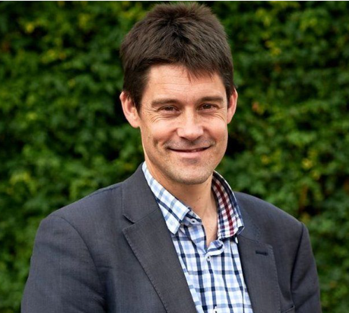
Break the poverty mindset in urban England
Edward Walker, from Peterborough setup Hope into Action (HiA) in the city in 2010.
Houses 315 people used to be homeless in 23 different towns and cities in the UK.
He has been appointed MBE in the Queen's Birthday Honours in 2022.
A helping hand to rebuild people’s self worthy, confidence and more

Slide 10
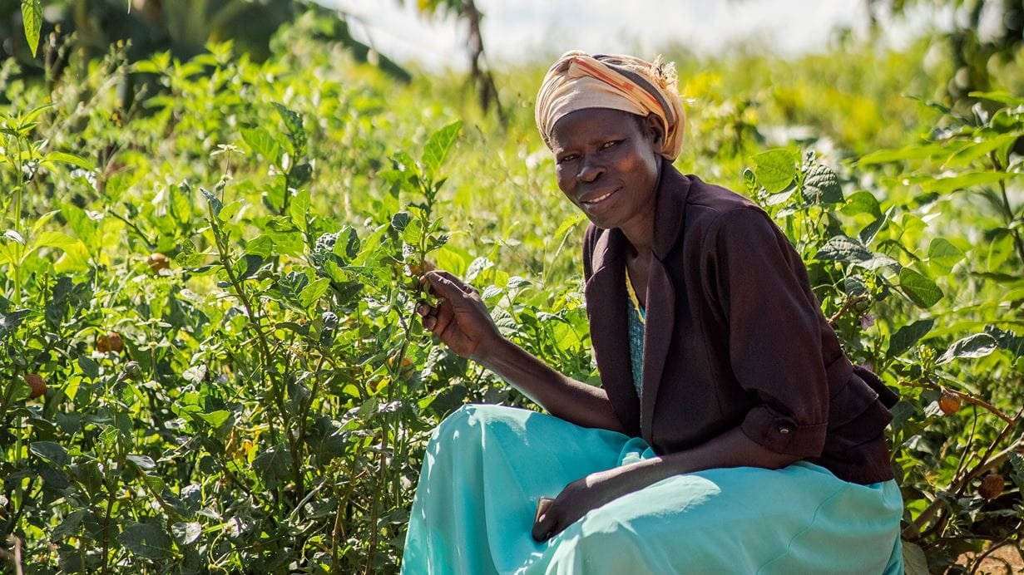
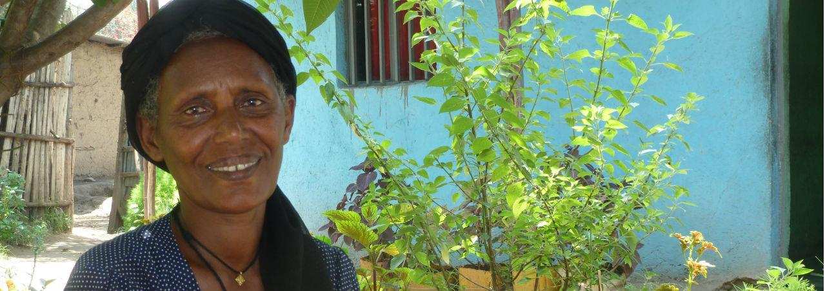
Break the poverty mindset around the globe
Provide a new vision, use people’s skills and talents, improves self esteem and sense of belongings
Tearfund Church Community Mobilization Programme and Self-Help Groups in 50 countries
Betty from Uganda Tsige from Ethiopia

Slide 11
Poverty is not God’s plan. You are!
Be the catalyst
Take actions to break the poverty mindset and help people restore hope.

